Slide 1
Sign Language Recognition System
Machine Learning

Slide 2
Agenda:
Group Member Information
Role/Responsibilities and Contribution in project
Motivation
Objectives
Related work
Problem Statement
Proposed Solution
Results/Simulations
References

Slide 3
Team Members Information:
Venkata Krishna Lakshmi Spandana Vegi | 700744287 (vxv42870@ucmo.edu)
Sindhu Rajanala | 700741228 (sxr12280@ucmo.edu)
Sai Swetha Nambari | 700742846 (sxn28460@ucmo.edu)
Venkata Lakshmi Sasank Tipparaju | 700738838 (vxt88380@ucmo.edu)

Slide 4
Roles & Responsibilities
Venkata Krishna Lakshmi Spandana Vegi | --algo
Sindhu Rajanala | --algo
Sai Swetha Nambari | --algo
Venkata Lakshmi Sasank Tipparaju | --algo

Slide 5
Motivation
Necessity to socialize with people as communication is important.
Sign language is like a bridge that connects hearing and speech disabled
People who understand hearing & speech disabled are very limited
Utilization of Machine Learning techniques in Sign Language Recognition Systems

Slide 6
Objective
The main objective for the sign language recognition system is to recognize the images by using various machine learning techniques for extracting the relevant features and subsequent classification.
The sign language recognition system checks so see if all the algorithms are able to classify the given sign language letters using the interpretation of the hand symbols .
The above recognition can be performed by the 3 steps given in the next slide.

Slide 7
Objective Cont..
Applying Course Knowledge & Experimenting with various machine learning algorithms
Get Classification report of each algorithm
Performance Metrics Comparison in terms of Accuracy

Slide 8
Related Work
“A New Benchmark on American Sign Language Recognition using Convolutional Neural Network"(M. M. Rahman et. al.,2019). The above-mentioned work gives us an idea on the detection of American Sign Language by using convolutional neural networks. About four datasets were considered with good reports. The performance of the proposed model is studied on each dataset when trained and tested. The model has an accuracy of 100% while recognizing both digits and alphabets and it has an accuracy of 99.90% with the digit and the sign language [2].
"ML Based Sign Language Recognition System" (K. Amrutha and P. Prabu,2021) This research talks about automated identification of SLR based on vision-based isolated hand gesture detection and recognition utilizing convex Hull feature extraction and KNN as classifier which yielded an 65% accuracy [3].

Slide 9
” Indian Sign Language recognition system using SURF with SVM and CNN” (Shagun Katoch et. at., 2022). In this work the Support Vector Machine and Convolutional Neural Networks are used for the classification. The training data used is 80% and 20% of the data is used for the purpose of testing. For classification SVM with linear kernel is used. SVM has given an accuracy of 99.14% on test data and overall accuracy of 99%. Whereas CNN has given an accuracy of 99% on testing data and overall accuracy of 94% on training data [4].
Related Work Cont..

Slide 10
Problem Statement
A communication gap occurs when conversing with a speech and hearing-impaired person if we don’t know the sign language.Sign language is important as it gives the bridge sport to the common people and people containing hearing and vocal disabilities.
The deaf and mute communicate through hand gestures ,but if the normal people can't understand the sign language, they might face problems in understanding what the former is conveying.
In order to solve this problem, we use sign language recognition system to bridge this communication gap.
Experimental Analysis of these machine learning algorithms XGBoost, LightGBM, Support Vector Machine, Decision Tree, and Random Forest in the area of SLRS.

Slide 11
Proposed Solution
Here we adopt the sequential method of machine learning which means we can import or export the data sequence like text streams, audio clips, video clips, time-series data, etc.,
Load the datasets from Kaggle, divide into two parts –
One to train and other for testing
Image Augmentation and Preprocess the data
To get better feature extraction – used CNN layering model on images
Train each ML algorithm and predict on test folder dataset
Providing classification report and accuracy

Slide 12
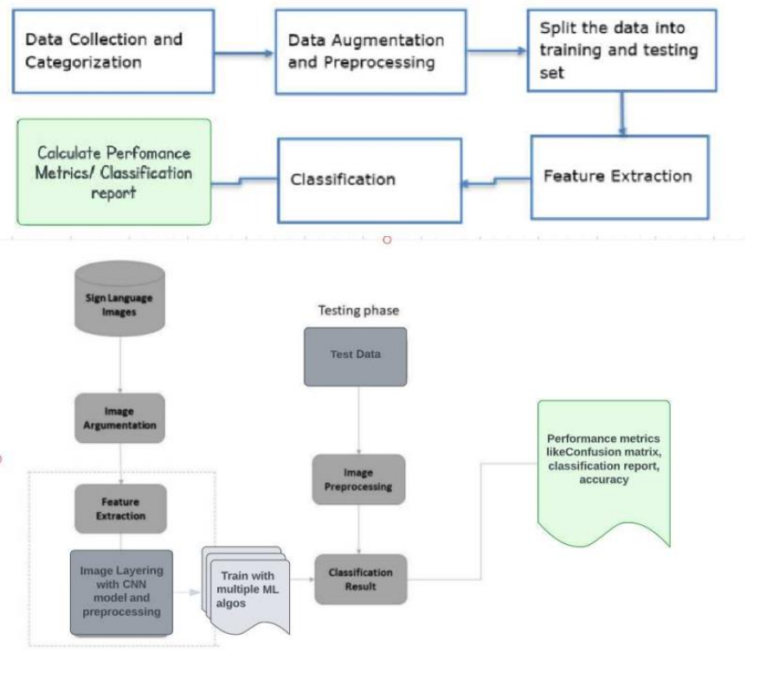
The above diagram shows us hoe the sign language recognition system works. First, we will collect the data with all hand gestures images files and categorize them with labels. On the collected dataset, we divided our approach to tackling the classification problem into three stages.

Slide 13
Proposed Solution
The first stage is to load the data after importing
Create final data frame by clubbing all the images along with alphabet labels.
Perform data augmentation for those images
Preprocess the data using CNN modal layering to extract good features
Load the data into each machine learning algorithm

Slide 14
Proposed Solution
Implemented Algorithms:
Logistic Regression
Decision Tree
Support Vector Machine
Random Forest
Xgboost
LGBM
on the Sign Language datasets to check the accuracy of each algorithm and provide an analysis of the performance metrics

Slide 15
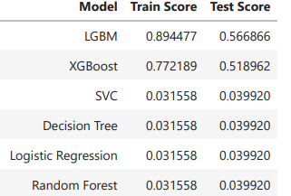
Results
After we train the machine learning algorithms, we got the classification report and confusion matrix for each algorithm, of which only LightGBM and XGBoost machine learning algorithms gave more accuracy compared to other machine learning algorithms i.e SVM, Decision Tree, Logistic Regression and Random Forest as shown in the above table.

Slide 16
After we train the machine learning algorithms, we got the classification report and confusion matrix for each algorithm, of which only LightGBM and XGBoost machine learning algorithms gave more accuracy compared to other machine learning algorithms i.e SVM, Decision Tree, Logistic Regression and Random Forest as shown in the above table.

Slide 17
References
World Health Organization WHO, [Online] Available: https://www.who.int/news-room/fact-sheets/detail/deafness-and-hearing-loss
M. M. Rahman, M. S. Islam, M. H. Rahman, R. Sassi, M. W. Rivolta and M. Aktaruzzaman, "A New Benchmark on American Sign Language Recognition using Convolutional Neural Network," 2019 International Conference on Sustainable Technologies for Industry 4.0 (STI), 2019, pp. 1-6, doi: 10.1109/STI47673.2019.9067974. [Online]. Available: https://ieeexplore.ieee.org/abstract/document/9067974/citations#citations
K. Amrutha and P. Prabu, "ML Based Sign Language Recognition System," 2021 International Conference on Innovative Trends in Information Technology (ICITIIT), 2021, pp. 1-6, doi: 10.1109/ICITIIT51526.2021.9399594. [Online]. Available: https://ieeexplore.ieee.org/abstract/document/9399594
Shagun Katoch, Varsha Singh, Uma Shanker Tiwary, ”Indian Sign Language recognition system using SURF with SVM and CNN,” Array, Volume 14,2022,100141,SSN 2590-0056, https://doi.org/10.1016/j.array.2022.100141 (https://www.sciencedirect.com/science/article/pii/S2590005622000121)
https://towardsdatascience.com/support-vector-machine-introduction-to-machine-learning-algorithms

Slide 18
Thank you

